Slide 1
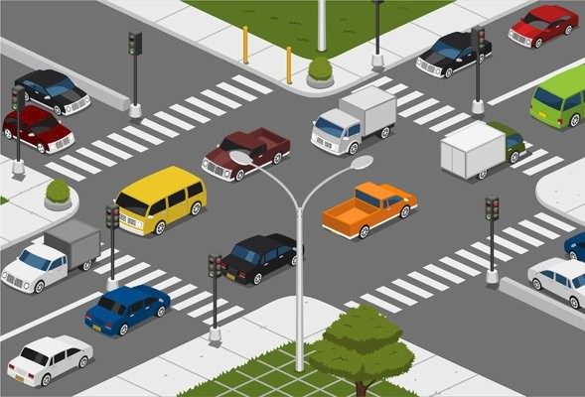
Neuro Fleet X – AI Powered Urban Fleet & Traffic Intelligence
TEAM-B
NARMADHA L
Pitch

Slide 2
PROBLEM STATEMENT
Our project aims to manage and control both autonomous vehicles and normal human-driven vehicles in future smart cities.
The system helps the city to:
Reduce traffic congestion
Predict and avoid high-risk areas
Guide vehicles through optimized routes
Monitor all vehicles in real time
Improve safety and traffic flow

Slide 3
SOLUTION
We provide one unified platform with three roles:
Admin (System Owner)
Manager (Traffic Controller)
Driver (Vehicle User)
AI supports all roles by analyzing traffic, vehicle density, speed patterns, and risk zones.

Slide 4
Neuro Fleet X – AI Powered Urban Fleet & Traffic Intelligence
Admin – System
Owner
2. Manager – Traffic
Controller
3. Driver – Vehicle User
(Human + Autonomous Unit)
Monitors traffic flow in different areas
Updates traffic density (for humans driving in crowded areas)
Verifies AI predictions
Checks vehicle statuses (both human + autonomous)
Manages risk zones and congestion alerts
Enters Source → Destination
Receives optimized AI route
Views traffic alerts and risk zone warnings
Updates GPS location
Checks vehicle health and performance
Controls the entire platform
Adds managers and vehicles (human or autonomous)
Views all city vehicle movement (live map)
Monitors congestion, risk zones, and alerts
Uses AI reports to make decisions

Slide 5
Project: Neuro Fleet X – AI Powered Urban Fleet & Traffic Intelligence
To cover all modules, we divided our team:
Admin Module: Narmadha L & Ganesh
Manager Module: Nitin
Driver Module: Dinesh

Slide 6
Project: Neuro Fleet X – AI Powered Urban Fleet & Traffic Intelligence
ADMIN ROLE:
Login → Secure JWT login
Dashboard → View vehicles, traffic status, and risk zones
User Management → Create and manage Admins and Managers
Driver Management → Add, update, and manage drivers
Vehicle Management → Add, edit, delete, and monitor vehicles
Alerts → Create, view, and resolve system alerts
AI Tools → Route suggestions and traffic analysis
AI Analytics → Monitor congestion levels and traffic risk insights

Slide 7
Project: Neuro Fleet X – AI Powered Urban Fleet & Traffic Intelligence
1. Admin Login (Authentication)
Feature:
Secure login using JWT authentication
What it includes:
Email + password login
Token-based access
Protecting Admin pages from unauthorized users
2. Admin Dashboard
Feature:
A real-time dashboard to monitor city traffic and vehicles.
What the dashboard will show:
Total vehicles (human-driven + autonomous)
Active vehicles
Idle vehicles
Stuck/busy vehicles
Live congestion levels
Risk zone heatmap (Critical, High, Medium, Low)

Slide 8
Project: Neuro Fleet X – AI Powered Urban Fleet & Traffic Intelligence
3. Vehicle Management
Feature:
Admin can manage all vehicles in the system.
What Admin can do:
Add new vehicles
Edit vehicle details (fuel level, status, type, etc.)
Delete vehicles (if no longer active)
4. User Management
Feature:
Admin controls who can use the system.
What Admin can do:
Add Manager accounts
Add Driver accounts
Update user information
Control user access (roles/permissions)

Slide 9
Project: Neuro Fleet X – AI Powered Urban Fleet & Traffic Intelligence
5. Alerts Management
Feature:
Handle traffic and system alerts efficiently.
What it includes:
Create new alerts
View all alerts
View unresolved alerts
Resolve alerts with one click
Severity levels (Low, Medium, High, Critical)
6. AI Tools
Feature:
Provide AI-assisted traffic and route support.
What it includes:
Route suggestion based on traffic conditions
Basic traffic analysis support
AI-assisted decision-making tools

Slide 10
Project: Neuro Fleet X – AI Powered Urban Fleet & Traffic Intelligence
7. AI Analytics
Feature:
Analyze traffic risk and congestion patterns.
What it includes:
Traffic risk level analysis
Congestion pattern visualization
Bar and pie charts for risk zones
Color-coded analytics for easy understanding

Slide 11
Project: Neuro Fleet X – AI Powered Urban Fleet & Traffic Intelligence
I am going to work on,
1.DASHBOARD
Total vehicles (human-driven + autonomous)
Active vehicles
Idle vehicles
Stuck/busy vehicles
Live congestion levels
Risk zone heatmap (Critical, High, Medium, Low)
2.VECHICLE MANAGEMENT
Add new vehicles
Edit vehicle details (fuel level, status, type, etc.)
Delete vehicles (if no longer active)

Slide 12
Project: Neuro Fleet X – AI Powered Urban Fleet & Traffic Intelligence
3. Alerts
View all system alerts
Create new alerts
Resolve alerts
Identify alerts by severity (Low, Medium, High, Critical)
4. AI Analytics
Analyze traffic congestion levels
Identify traffic risk zones
View risk data using charts and visuals
Support decision-making using basic AI logic

Slide 13
THANK YOU…..

